Slide 1
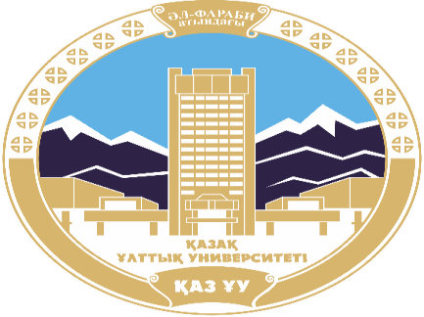
AL-FARABI KAZAKH NATIONAL UNIVERSITY
Department of political science and political technologies
Political systems and regimes
Abzhapparova A.A.
Senior lecturer

Slide 2
Political systems and regimes
Lecture 3
Typology of political systems

Slide 3
Lecture plan:
Typology of political systems.
The institutional model the political system of D.Easton.
The basic concepts and patterns of the theory of systems.
Examples of system classification.

Slide 4
TYPOLOGY OF POLITICAL SYSTEMS
a way of classifying political systems, which are understood as a set of laws, norms, organizational structures, institutions that constitute a state or other political entity. As a rule, the main criterion for determining a political system is the organization of its government and the ways it is formed. The main distinction in modern political science concerning political systems is their division into autocracies and democracies. These concepts may contain subtypes, for example, "electoral autocracy" or "imperfect democracy".

Slide 5
R. Dahl distinguished 3 types of systems (based on the degree of democracy of power):
Totalitarian: a single government, a single party, the people have no right to vote.
Authoritarian: practically indistinguishable from totalitarian, but people have some opportunity to influence politics.
Democratic: party pluralism, the power of the people, the authorities are elected on the basis of general elections.

Slide 6
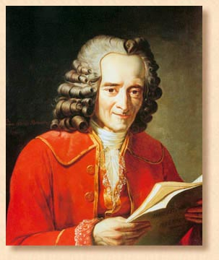
TYPOLOGY OF POLITICAL SYSTEMS
Source of political power
Attitude to reality
State of the political structure
Nature of the political process
Democratic (constitutional)
Conservative
Anglo-American
Command
Autocratic
Reformatory
Continental-European
Competitive
Progressive
Pre-industrial (partially-industrial)
Socio-conciliatory
Interaction with the external environment
Reactionary
Totalitarian system
Open ones
"I don't agree with what you say, but I will defend to the last drop of my blood your right to express your own point of view."
(Voltaire, philosopher)
Closed ones
14

Slide 7
K. Marx, F. Engels, V. I. Lenin distinguished 4 types of political systems (based on socio-economic decisions):
Slaveholding, in which society is clearly divided into slaves and their masters.
Feudal, where the division takes place at the class level: peasant and feudal. The transition from class to class is almost impossible.
Capitalist, where the main role is played by capital, the size of which depends on the capabilities of its owner.
Socialist, implying an equal division of resources among all members of society, regardless of origin, education, age, etc. There is no division into classes.

Slide 8
The main concept of R.Dahl is the analysis of the degree of democratization of power and mechanisms for resolving contradictions. The main political systems:
Democratic;
Authoritarian;
Totalitarian

Slide 9
Democratic
Democracy is a type of political system of society in which legislative and executive functions are carried out both through direct democracy (direct democracy) and through representatives elected by the people or any part of it (representative democracy). The main feature of democracy is legislatively secured electoral forms as proportional representation in government (collective body) as well as authoritarian representation (the president), and the mandatory presence of any forms of inalienable rights of citizens, which carry a mechanism for protecting the interests of minorities.

Slide 10
Authoritarian
An authoritarian political system is a system based on the unlimited power of one person or group of persons while preserving some economic, civil, and spiritual freedoms for citizens. The term "authoritarianism" was introduced into scientific circulation by the theorists of the Frankfurt school of neo-Marxism and meant a certain set of social characteristics inherent in both political culture and mass consciousness in general. A political system consistent with the principles of authoritarianism means the absence of genuine democracy both in terms of the free conduct of elections and in matters of governance of State structures. It is often combined with the dictatorship of an individual, which manifests itself to one degree or another.

Slide 11
Totalitarian
A totalitarian system is a political system that strives for full (total) control of the state over all aspects of society. In comparative political science, the totalitarian model is understood as the theory that fascism (in particular, Nazism), Stalinism and, possibly, a number of other systems were varieties of one system — totalitarianism.

Slide 12
G. Almond divided political systems into 4 types (based on political culture):
Anglo-American, which has a homogeneous culture: political goals and ways to achieve them are acceptable to all. All general political relations are divided by specialization, and power and influence within the system are clearly divided.
Continental European, characterized by a fragmented policy with common sources. It allows for the equal existence of old and new cultures, as well as the presence of different points of view that are equal to each other.
Pre-industrial and partially industrial have a mixed political culture and differ in the difficulties of coexistence and interaction of all elements of the system, which leads to the need to use violence to control public relations.
Totalitarian, characterized by the domination of coercion and total supervision of the whole society and each of its representatives in particular. Voluntary associations are unacceptable, there can be only one recognized party.

Slide 13
V. E. Chirkin: 3 types (based on the ways of managing society):
Administrative and command structure: one party dominates, economic life is conducted exclusively on the basis of state property, there is no economic freedom.
Competitive: political pluralism with fierce competition of political forces.
Socio-conciliatory: the predominance of political cooperation over competition (or its apparent absence). It is typical for civilized states.

Slide 14
V. V. Radaev, O. N. Shkartan: 2 types (based on the role and place of the state in the political system):
A kind of democratic one: the power belongs to the oligarchy.
Democratic: power belongs to the people.

Slide 15
TYPOLOGY OF POLITICAL SYSTEMS (St. Petersburg State University)
By the nature of relations between the political system and civil society
Classification of J. Blondel
Communist (radical-authoritarian)
Executive
(Society is the basis of the state and politics)
Liberal Democratic
Traditional
Modernized
(state / politics imposes innovative projects on civil society – managerial revolution)
Populist
Authoritarian-conservative
Postmodernism
(politicians produce political events as a commodity-elections, revolutions; this is a game of professionals for the sake of power, career, statuses)
S. 266-268 manuals of St. Petersburg State University
14

Slide 16
French political scientist J. Blondel distinguishes political systems by their content and forms of government and, accordingly, identifies five main varieties:
liberal democracies;
communist systems;
traditional political systems;
populist political systems;
authoritarian-conservative political systems

Slide 17
Liberal democratic systems
Liberal democratic systems are shaped by a market-type social environment. Liberal democracy (also called polyarchy) is a form of socio—political structure - a state governed by the rule of law based on representative democracy, in which the will of the majority and the ability of elected representatives to exercise power are limited in the name of protecting the rights of a minority and the freedoms of individual citizens. Liberal democracy aims to ensure that every citizen has the equal right to due process of law, private property, privacy, freedom of speech, freedom of assembly and freedom of religion. These liberal rights are enshrined in higher laws (such as the constitution or statute, or in case-law decisions issued by supreme judicial instances), which, in turn, empower various State and public bodies to ensure these rights.

Slide 18
The communist system
The communist system is an organization of society in which the economy is based on public ownership of the means of production. Such a formation, according to the works of the founders of Marxism, presupposes the presence of highly developed productive forces, the absence of division into social classes and the abolition of the state, in which there should have been no money and the principle of "everyone according to their abilities — everyone according to their needs" is implemented. Communism is a highly organized society of free and conscious workers, in which public self—government is established, work for the benefit of society becomes the first vital need for everyone, a conscious necessity, and everyone's abilities are used with the greatest benefit to the people."
The basic principles of the communist system are: public ownership of the means of production, relations of cooperation and mutual assistance, conscious labor discipline, planned management of the national economy, subordination of the economic and cultural progress of society to the goals of achieving full well-being and comprehensive development of all its members, social unity of society based on the community of fundamental interests of workers, Marxist-Leninist ideology, management of public affairs, carried out on the basis of scientific knowledge of economic laws and principles of the communist worldview

Slide 19
The traditional political system
The traditional political system is a system in which power is concentrated in the hands of a narrow circle of people (oligarchs) and corresponds to their personal interests, not the common good. Domination in the state or the financial sphere belongs to a small group of people connected by common interests, often narrowly selfish. By concentrating in their hands dominance over economic sectors and other spheres of public life, they seek to dictate their terms. The economic prerequisite for education is the process of concentrating financial resources in the hands of a narrow group of the rich.

Slide 20
A populist political system
A populist political system uses authoritarian methods of governance and strives for greater equality in the distribution of benefits. Populism is an ideologically speculative orientation of political subjects towards the political ideas of the broad masses who are dissatisfied with their lives. Populism as a phenomenon was in demand in industrial society among the part of the population that was "intermediate" between the bourgeoisie and the proletarians. The bearers of the ideas of populism include peasants, farmers, the petty bourgeoisie, part of the proletariat, lumpens, etc.

Slide 21
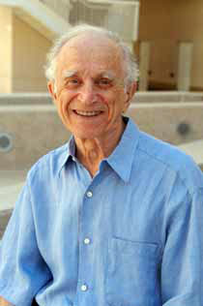
The institutional model the political system of D.Easton
The founder
a systematic approach
in political science, it is considered to be
canadian scientist,
who worked in the United States,
By David Easton

Slide 22
The institutional model the political system of D.Easton
D. Easton believed that " a systematic analysis of political life is based on the concept of "a system immersed in an environment" and exposed to its actions.
Political system - "black box". Its relations with the environment are analyzed mainly, and the processes taking place inside it are ignored.
This analysis assumes that the system must have the ability to respond in order to survive.

Slide 23
The institutional model the political system of D.Easton
entrance
exit
requirements
decisions
System
support
actions

Slide 24
At the entrance: Political
the system receives
entrance
entrance
entrance
requirements
entrance
system
system
this is an expression of opinion that,
to allow authorized persons to do so
(the president, government, deputies, etc.) made or did not make a voluntary distribution in relation to some object
For example,
increase the minimum wage
appropriations for medical services
adopt a particular law

Slide 25
A large number or complexity of requirements can
overload a system that is unable to
run them, so it adjusts them.
Requirements
Requirements
Structural regulation
It consists of access to the political system through certain structures – "doors" guarded by "gatekeepers".
Cultural regulation it is based on cultural norms that do not allow or restrict certain requirements, such as prohibiting the use of violence in politics
Regulation
requirements
system

Slide 26
"Gatekeepers"
structural regulation
requirements
parties
members of parliament
organizations
filter requirements,
delaying some
and skipping others.
Authorities can anticipate the requirements in order to prevent conflicts in society or increase their popularity.
Thus, in addition to inputs from the environment, there are
also, the internal policy of the system ("inputs from within").

Slide 27
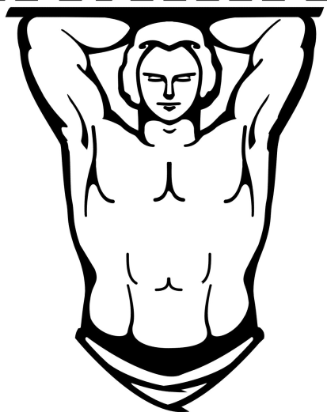
At the entrance: Political
the system also receives
entrance
system
support services:
patriotism
respect for institutions and laws
voluntary payment of taxes
loyalty to a specific management team
conscientious performance of civil duties

Slide 28
exit
decisions and actions,
satisfying requirements:
system
new laws
government appropriations
raising pensions
setting benefits
For the political system to survive, it must
convert incoming requirements and support to
appropriate decisions and actions, which is only possible if:
the presence of its ability to self-regulate.
The political process turns out to be a process of transformation
transfer information from "input" to "output":
responding to environmental signals, the political system
At the same time, it implements changes in the company and supports its employees.
stability

